Slide 1
PtSA / Momentum Medical Assistance Scheme for the benefit of PtSA members
March 2022
Presenter- Marizanne van Niekerk

Slide 2
PtSA / Momentum Medical Assistance Scheme
PtSA has worked closely with Momentum, a PtSA Partner, to reach an agreement which will offer PtSA members a medical insurance product as well as a Medical Aid Scheme, depending on the income levels of the members’ employees.

Slide 3
Why Momentum?
Growth experience in traditional markets (Retail and corporate)
Attracting and retaining the right profile of members
Financially stable
Consistently one of the lowest claims ratios in the industry

Slide 4
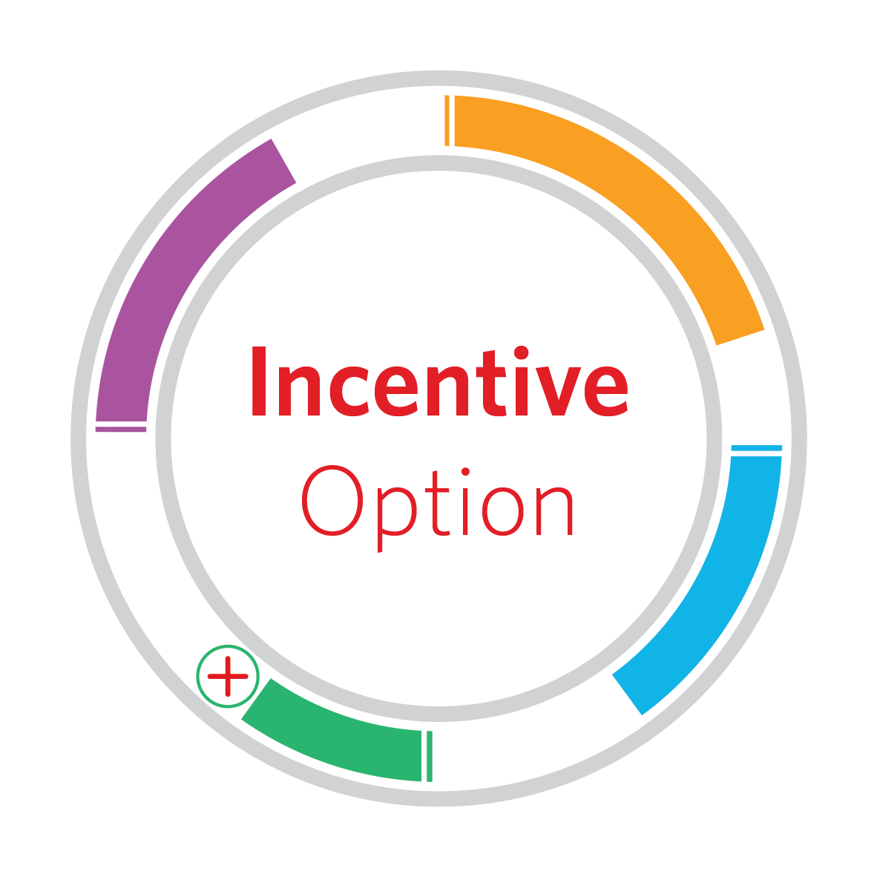
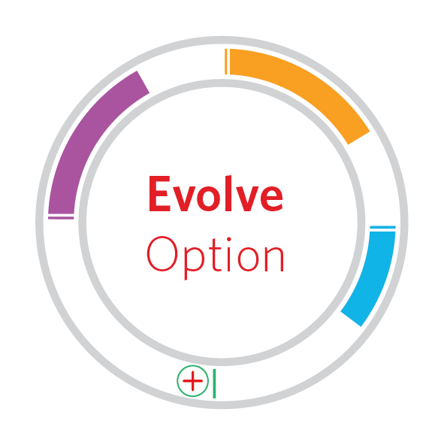
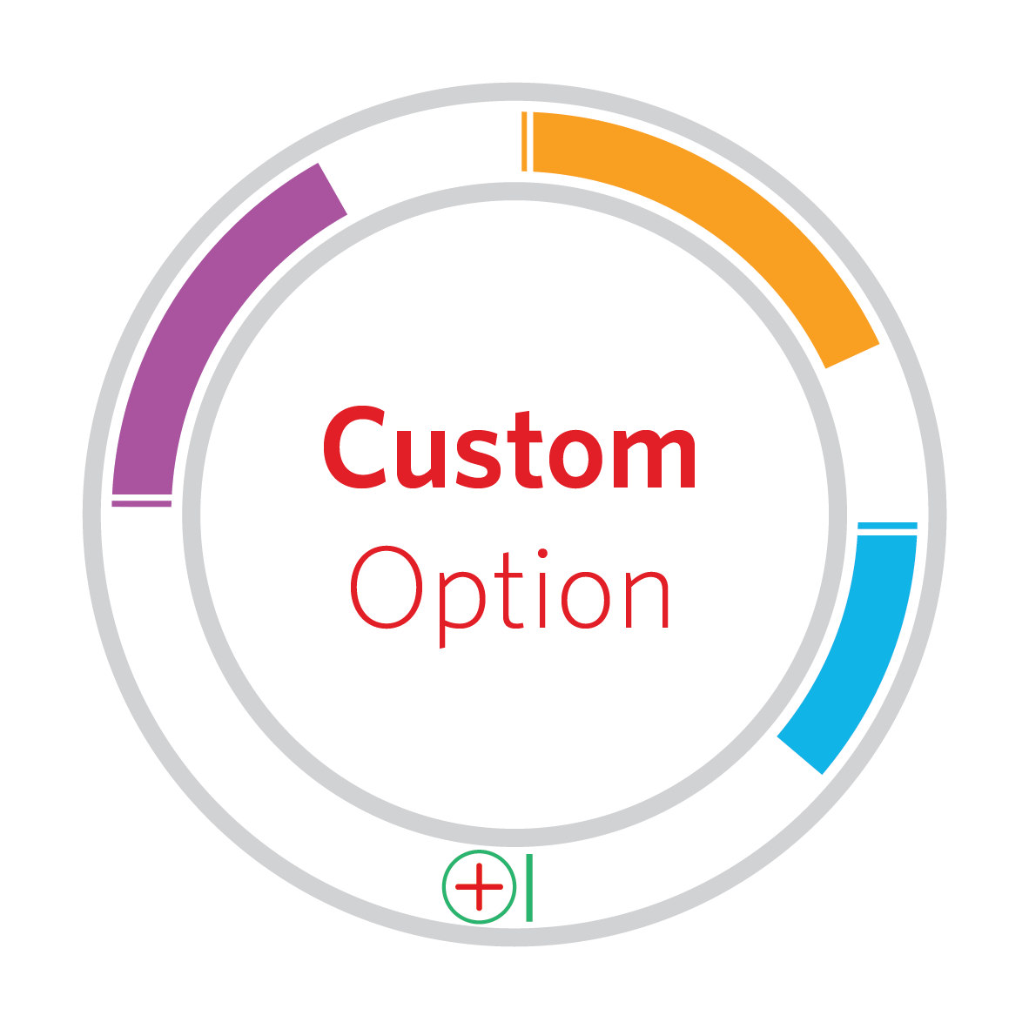
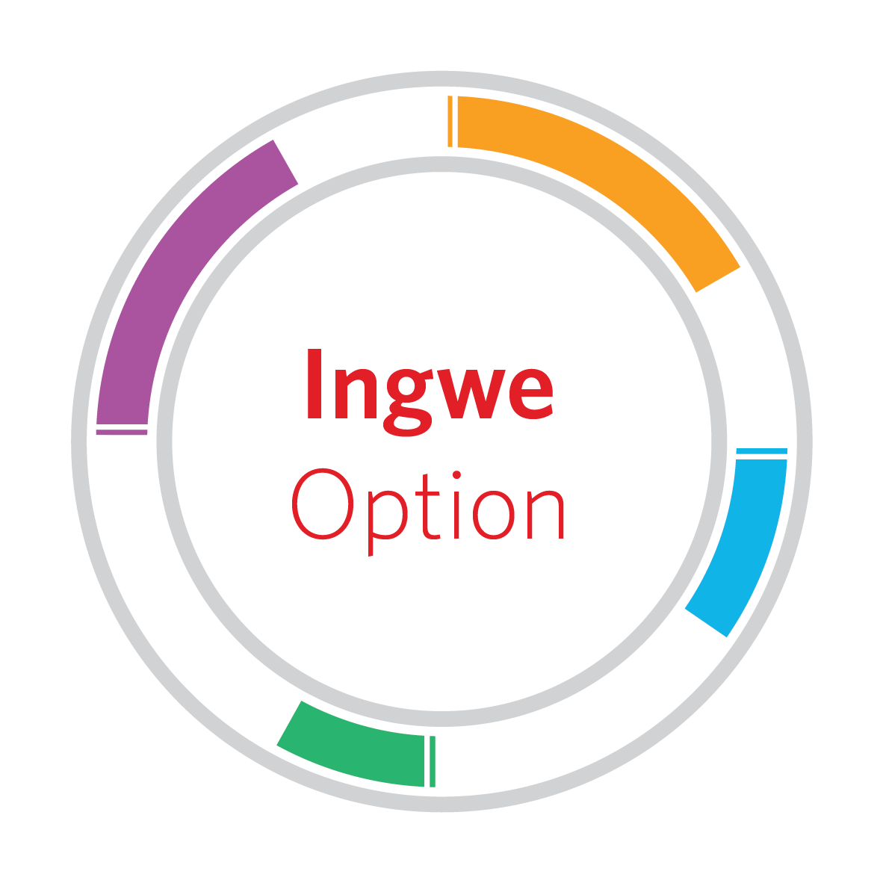
PtSA / Momentum Medical Assistance Scheme – 4 options
Entry level cover
Every day options
Provider choice
Medical needs
Network option focusing on primary care
10% savings with Hospital and Chronic benefits, provider choice
Millennials = Zero savings with Major Medical and Chronic benefits
2 Virtual consultations per beneficiary paid from risk
Zero savings with Hospital and Chronic benefits, provider choice

Slide 5
Support - MCA working with PtSA members (Employers)
Momentum Consultants & Actuaries (MCA) is the appointed Healthcare Consultant (Healthcare Broker) for PtSA members for the PtSA/ Momentum Medical Assistance Scheme.
PtSA Member will contact MCA Team and a formal Needs Analysis discussion will take place (voluntary vs Compulsory participation, subsidy arrangements, income of employees, Medical Scheme and/or Insurance product requirements etc.)
Demographics of each group needs to be submitted to MCA for any Medical Scheme and / Insurance product underwriting request and quotations (5-10 working days)
MCA will set up a feedback meeting and the implementation will be discussed and confirmed
NB!!
Medical Scheme – no preferential rate per group – Legislated
Insurance Product – rate will vary slightly based on demographics submitted
MCA income – directly from Scheme/Insurer – no additional cost to the Employer

Slide 6
Ongoing Support by MCA Service to PtSA members
MCA will assist with implementation (Employer as well as Employees)
Member presentation sessions and/or one-on-ones will be arranged, and option selection will be based on the needs of each individual
Application and activation process
Ongoing support to Employer and Employees – Claims, Membership matters, hospital admission authorisations etc) via a dedicated Consultant and MCA Helpdesk available (telephone line 0861 and Email / dedicated Email address)

Slide 7
Ingwe Network
Evolve Network
Any / Associated Provider
Ingwe Network
State
Any / Associated / State Provider
Unlimited - Ingwe Network providers
2 Hello Doctor
GP Virtual Consults
10% Savings
Health Platform Benefits (Preventative Screening Benefits)
HealthSaver
More4Me
HealthReturns
HealthReturns and KidsReturns
Hello Doctor Employee Assistance Programme Momentum GapCover
Momentum Multiply
Health Platform Benefits (Preventative Screening Benefits)
HealthSaver
More4Me
HealthReturns
HealthReturns and KidsReturns
Hello Doctor Employee Assistance Programme Momentum GapCover
Momentum Multiply

Slide 8
PtSA / Momentum Medical Assistance Scheme offers 5 products
PRODUCT | CATEGORY | MONTHLY COST | BENEFITS
Health4Me | Medical Insurance | R294 Main Member R294 Adult Dependent R148 Per Child (max 4) | · GP visits to a network of GPs · Day-to-day benefits through a network of private doctors and specialists
Ingwe Network | Medical Aid | From R940 (main member) | · Hospital Cover at private hospital (Network list) · Chronic cover (27 PMB Conditions) · Day-to-day benefits only at network providers (GP, limited specialist, medication, basic radiology & pathology, basic dentistry and optometry) · Add Health Saver (Savings Account) for additional day to day expenses
Evolve | Medical Aid (Excludes Chronic) | R1 345 | · Hospital Cover at private hospital (Network list) · Add Health Saver (Savings Account) for day to day expenses
Custom | Medical Aid | From R1 706 (Based on Members’ choice) | · Hospital Cover at private hospital (any hospital or Associated Network list) · Chronic cover (27 PMB Conditions) · Add Health Saver (Savings Account) for day to day expenses
Incentive | Medical Aid | From R2 224 (Based on Members’ choice) (Includes 10% for Medical Savings) | · Hospital Cover at private hospital (any hospital or Associated Network list) · Chronic cover (27 PMB Conditions + additional 6 Conditions) · Day-to-day expenses paid from Medical Scheme Savings Account (10% of contribution · Add Health Saver (Savings Account) for additional day to day expenses

Slide 9
What is the Next Step?
Contact PtSA Office to set up a meeting with MCA
Thank you

