Slide 1
Enterprise Development Service Offering

Slide 2
About the Production Technologies Association of South Africa
The Production Technologies Association of South Africa (PtSA), established in 2006, is a membership-based organisation with the mission of promoting, protecting and supporting the collective interests of the Tool, Die, Mould and Special Machining industries (TDM Industry) of South Africa, enabling the development and sustainability of all manufacturing sectors.
As part of this mission, the Association has entered into a partnership agreement with government (represented by the Department of Trade Industry and Competition), the INTSIMBI Future Production Technologies Initiative, to develop programmes to address the needs of the TDM Industry in order to rehabilitate and grow the industry for the benefit of the manufacturing sector in South Africa.

Slide 3
Programmes offered to the TDM Industry
These programmes are divided into two primary sections:
Enterprise Development
Skills Development
The INTSIMBI Future Production Technologies Initiative programmes are implemented by the PtSA wholly owned project management and implementation agency, National Technologies Implementation Platform (Pty) Ltd.

Slide 4
Enterprise Development Programme
Improvement of company performance and profitability
Programme
Action
Benchmarking
Measuring current status of a company
Determining actions that should be taken to implement improvements.
Detailed focus workshops to address strategic areas of improvement.
Intervention Project

Slide 5
PtSA has a Strategic Partnership with the WBA
The WBA Aachener Werkzeugbau Akademie GmbH (WBA Institute Aachen Germany) is the world authority on tooling-related research and consulting.

Slide 6
Benchmarking
- is an efficient tool to compare yourself with competitors
Presentations of benchmarking results per key performance area
Lessons learned from benchmarking results
Comparison group: International best practice
(Top 20 tool shops of the excellence in production award 2018)
Identification of own position in reference to competitors
Analysis of market potential
Identification of desired position
Derivation of measures to achieve the target position
Access to expertise on best practices
Average: Database average based on specific configuration
Optimisation
Best or worst in class
Company
Current
Position
Best or worst in class
Comparison group: Chinese competitors
Comparison: South African competitors
The identification of strengths and potentials of the toolroom is a key result of the benchmarking and basis for a solid strategic improvement process.

Slide 7
The Benchmarking Process focusses on 12 areas of the TDM Industry
Market Intelligence (Market Knowledge)
Service Integration (Product Support)
Collaboration (Clustering)
System Environment (Advanced Support Systems)
Market Appearance
Product Innovation
Manufacturing Process Structure
Technology Capability
Strategy
Product Focus
Shop Floor Management
Employee
Qualifications (Skills)
MARKET
PRODUCT
PROCESS
RESOURCES

Slide 8
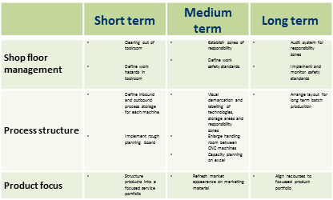
Intervention Project
Implementation Process
1. Company profiling
2. Analyse capabilities
3. Derive measures
Process: Pre-defined analysis tools based on the macro and micro company environment will be used.
Process: Tools directed to the specific company structures will be executed with a specific aim to uncover company strengths and potentials.
Process: Measures will be derived from a workshop and detailed into short, medium and long term measures.
Strengths
Process
Employees
Potentials
Costing
Result: A comprehensive overview of the companies products, processes, resources and customers.
Result: A detailed understanding of the strengths and potentials of the company.
Result: Documented and mutually agreed measures for the company to execute in the required timeframe.

Slide 9
Example of an Intervention Project Identified industrialised action fields
Networking with Customer through
Life Cycle Support
Efficient Order Processing
through
permanent process optimisation
Market Intelligence (Market Knowledge)
Service Integration (Product Support)
Collaboration (Clustering)
System Environment (Advanced Support Systems)
Standardisation of Tools
through specific design standards
Market Appearance
Product Innovation
Manufacturing Process Structure
Technology Capability
Strategic Focusing
through Advancing Core Competencies and Systematic Outsourcing
Shop floor Management
Cleanliness and tidiness
Strategy
Product Focus
Shop Floor Management
Employee
Qualifications (Skills)
MARKET
PRODUCT
PROCESS
RESOURCES

Slide 10
Status of companies assisted to date (2011 – 2020)
Companies assisted

Slide 11
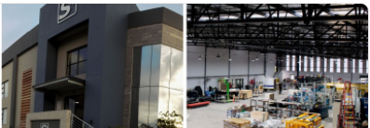
Actual feedback from companies after having participated in the Enterprise Development Programme
S4 Integration, a member of PtSA and situated in Gqeberha in the Eastern Cape, has recently undergone a PtSA Intervention Project to improve their competitiveness in order to better service their local and international customers.
Andrew White, MD of S4 Integration, says “the project has helped us to focus on some of the important issues which will assist us to improve and grow the company’s competitiveness for the benefit of our customers and employees”.
The following improvement measures were recommended by the PtSA Enterprise Development team:
• Improved shopfloor layouts,
• Improvements to the company website,
• Improved marketing strategies for the company including online marketing,
• Improved shop floor management processes,
• Displaying company vision and mission on the shopfloor, and
• Implementing cost benefit analysis tools.

Slide 12
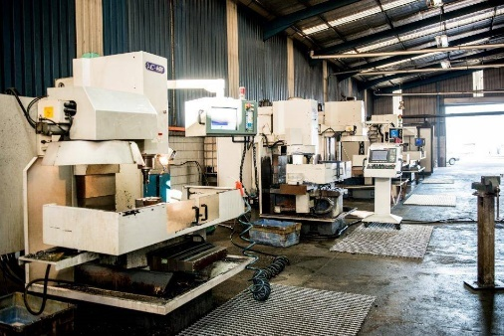
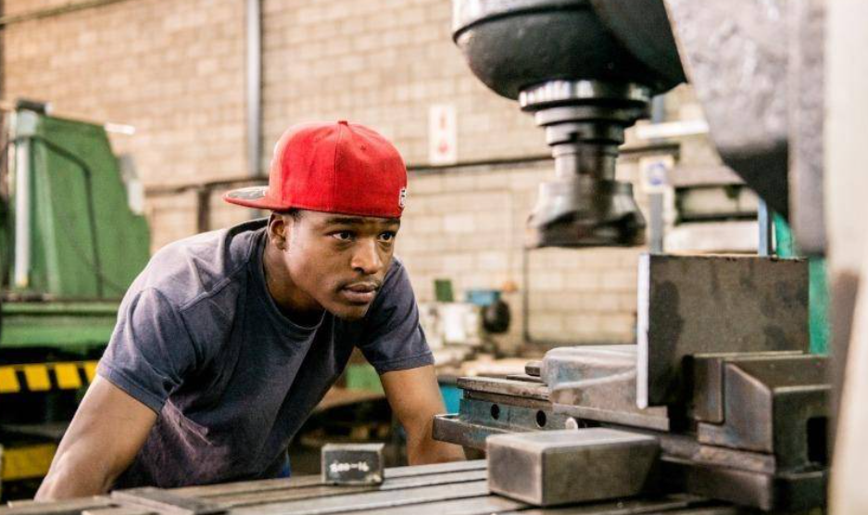
Actual feedback from companies after having participated in the Enterprise Development Programme
AE Manufacturing, a member of PtSA which offers specialised services such as designing, precision machining, reverse engineering & fabrication to name a few, participated in an Enterprise Development project funded by the Eastern Cape DEDEAT through the AIDC Eastern Cape to improve the company’s competitiveness.
The project, undertaken by PtSA Enterprise Development, followed a 3-stage approach which included company profiling, analysis of the company’s capabilities and determination of the measures required to improve efficiencies.
Simon Meyer from AE Manufacturing had the following to say about the project: “AE Manufacturing is experiencing rapid growth. The PtSA Enterprise Development project has helped us to address areas which are impacted by this growth and to consolidate and improve core processes in the business model and better prepare for the growth”.

Slide 13
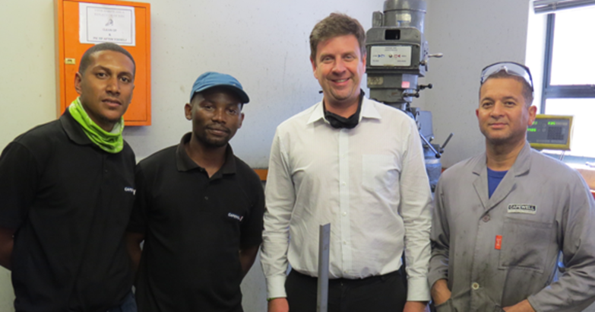
Actual feedback from companies after having participated in the Enterprise Development Programme
Capewell Springs and Metal Pressings, a PtSA member, participated in a PtSA Enterprise Development Benchmarking and Intervention Project. The company, based in Cape Town, supplies a wide range of industries with various springs and metal pressings.
Emile Coetzee, owner of Capewell Springs and Metal Pressings, said “the benchmarking process really made us aware of our shortcoming and potentials. The subsequent intervention project was critical in helping the company with the implementation and execution of the needed changes. We are extremely positive about the results of this project”.

Slide 14
Actual feedback from companies after having participated in the Enterprise Development Programme
Capewell Springs and Metal Pressings, a PtSA member, participated in a PtSA Enterprise Development Benchmarking and Intervention Project. The company, based in Cape Town, supplies a wide range of industries with various springs and metal pressings.
Emile Coetzee, owner of Capewell Springs and Metal Pressings, said “the benchmarking process really made us aware of our shortcoming and potentials. The subsequent intervention project was critical in helping the company with the implementation and execution of the needed changes. We are extremely positive about the results of this project”.

Slide 15
Contact Information
In order to participate in these projects, contact the Regional Manager in your area:
Gauteng Region
Francois Beetge
Mobile: +27 79 504 9387
Email: FrancoisB@PtSA.co.za
KwaZulu-Natal Region
Richard Kannigan
Mobile: +27 73 418 5044
Email: RichardK@PtSA.co.za
Eastern Cape Region
Theo van Rooyen
Mobile: +27 82 562 3087
Email: Theovr@PtSA.co.za
Western Cape Region
André Davies
Mobile: +27 62 6013 1301
Email: AndreD@PtSA.co.za

