Slide 1
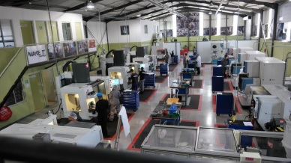
Western Cape Regional Centre of Excellence
Presented by
Andre Davies Regional Manager
Vincent Nel Industry Liaison Officer
Networking Event
07 April 2022
Notes:
Introduction of myself and Andre
Thank you for the opportunity to show case our organization and what and why we do things .refer to Mission statement
In slide show

Slide 2
PtSA MISSION
Growth
Development
Promoting
Protecting
Supporting
Promoting, protecting and supporting the collective interest of the Tool, Die , Mould and Special Machining Industries of South Africa in support of the growth and development of all manufacturing sectors
TOOL, DIE, MOULD & SPECIAL MACHINING INDUSTRIES OF
SOUTH AFRICA
Notes:
Focus on diagram to show case our Mission statement
Need to have a direction and focus point so that the industry can see the growth within the industry

Slide 3
ENTERPRISE DEVELOPMENT SERVICE OFFERING
Measuring current status of a company
Determining actions that should be taken to implement improvements.
BENCHMARKING
Detailed focus workshops to address strategic areas of improvement.
INTERVENTION
Notes:
Services offered to the industry to help companies to reach new high’s
To improve the industry as a whole

Slide 4
WHAT DO COMPANIES SAY ABOUT THE PROGRAMME?
“This Programme resulted in great benefits for the company. The net effect of our participation in the PtSA Benchmarking process, has first and foremost been a substantial increase in our productivity. Our output more than doubled with, in essence, no investment in capital equipment. This led to us being more competitive which, in turn, increased profitability. Being profitable makes our business more sustainable.”
- Lasni Millar, MD of Wagner Systems
Notes:
Benchmarking recently

Slide 5
WHAT DO COMPANIES SAY ABOUT THE PROGRAMME?
“The ED team introduced Trello, a web-based Kanban style programme to improve the process flow through our workshop. They also implemented a rework process flow and report as well as implementing S6 to mark out the workshop and standardize each workstation which improves time management and productivity. It was an eye opener to see how a small change in each area makes a huge difference.”
- Dewet van Veijeren, Robbie Deyzel Engineering
Notes:
Small changes can lead to huge savings
Pair of fresh eyes looking at things

Slide 6
NETWORKING AND MATCHMAKING
WEBINARS
- ISTMA Webinars
NATIONAL and REGIONAL NETWORKING EVENTS
PtSA CONFERENCES
PtSA CONVENTIONS
Notes:
Through theses platforms the industry can benefit
Check out the latest newsletter about a collaboration between local and international company
Creating the platform for industry to get together and talk shop

Slide 7
SKILLS DEVELOPMENT
TDM Apprenticeship Programme
- Currently 14 students 2018
- Recruitment of 9 students 2021
-Recruitment of 15 students 2022
Short Courses that benefit the TDM industry
Notes:
July intake 15 students
Due to covid break in the system
Company self-paying students to improve their work force
Criteria to needs to be met
Skills questionnaire that had the outcome June start Part time qualification CNC Turn &Mill developed by SS

Slide 8
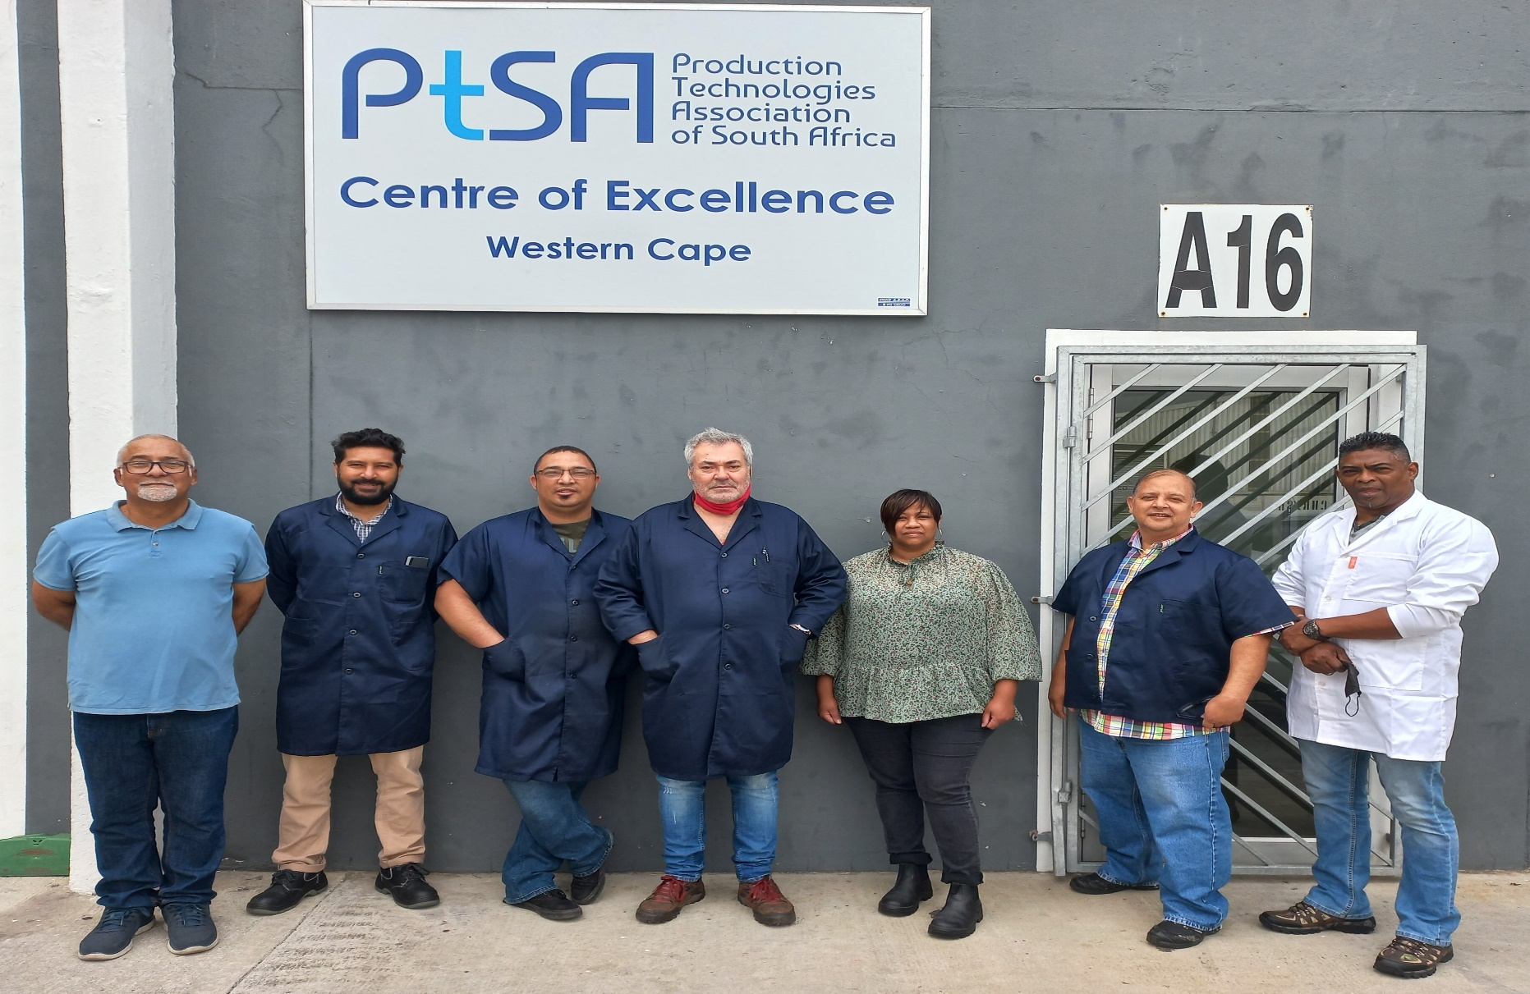
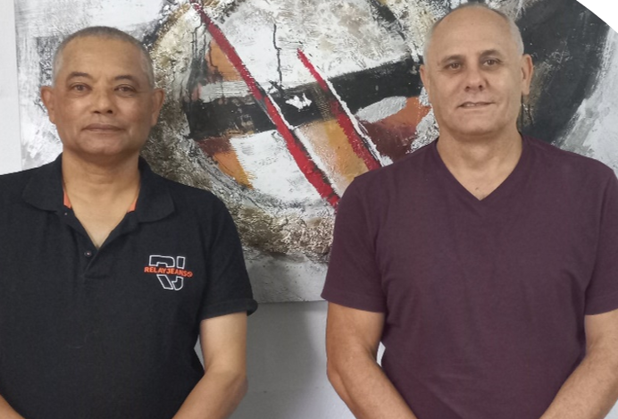
PtSA WESTERN CAPE CENTRE OF EXCELLENCE TEAM
The team consists of Regional Manager, Industry Liaison Officer, Student Officer and Lecturers
Specialised Services
Notes:
Team responsible for this

Slide 9
WESTERN CAPE REGIONAL STRUCTURE
PtSA Western Cape Exco
PtSA Regional Manager (fulfills the role as Secretariate to the Exco)
PtSA Industry Liaison Officer (interface between TDM Industry and PtSA)
PtSA Student Liaison Officer (support for TDM students)
PtSA Regional Lecturers (skilled qualified Toolmakers with extensive industry experience)
PtSA Trade Test Centre SAQA ID 91796 / 103177
Notes:
Layout is as follows
Myself and Andre for filling that role
Audrey
Knowledge that’s being passed on from the training center side but requires the input from the OJT part
Which is playing a mayor Role in the completing of the process

Slide 10
CONTACT INFORMATION
Western Cape Regional Manager
André Davies
Mobile: +27 62 6013 1301
Email: AndreD@PtSA.co.za
Industry Liaison Officer
Vincent Nel
Mobile: +27 82 674 85713
Email: VincentN@PtSA.co.za
Student Liaison Officer
Audrey Jacobs
Mobile: +27 67 818 9965
Email: AudreyJ@PtSA.co.za
Notes:
Contact details
Thank you

