Slide 1
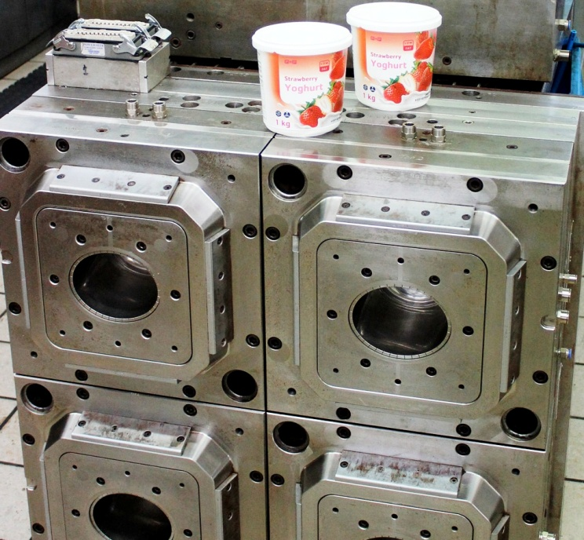
Chinaplas 2012
Paul de Villiers
National Executive
Polyoak Mould Services

Slide 2
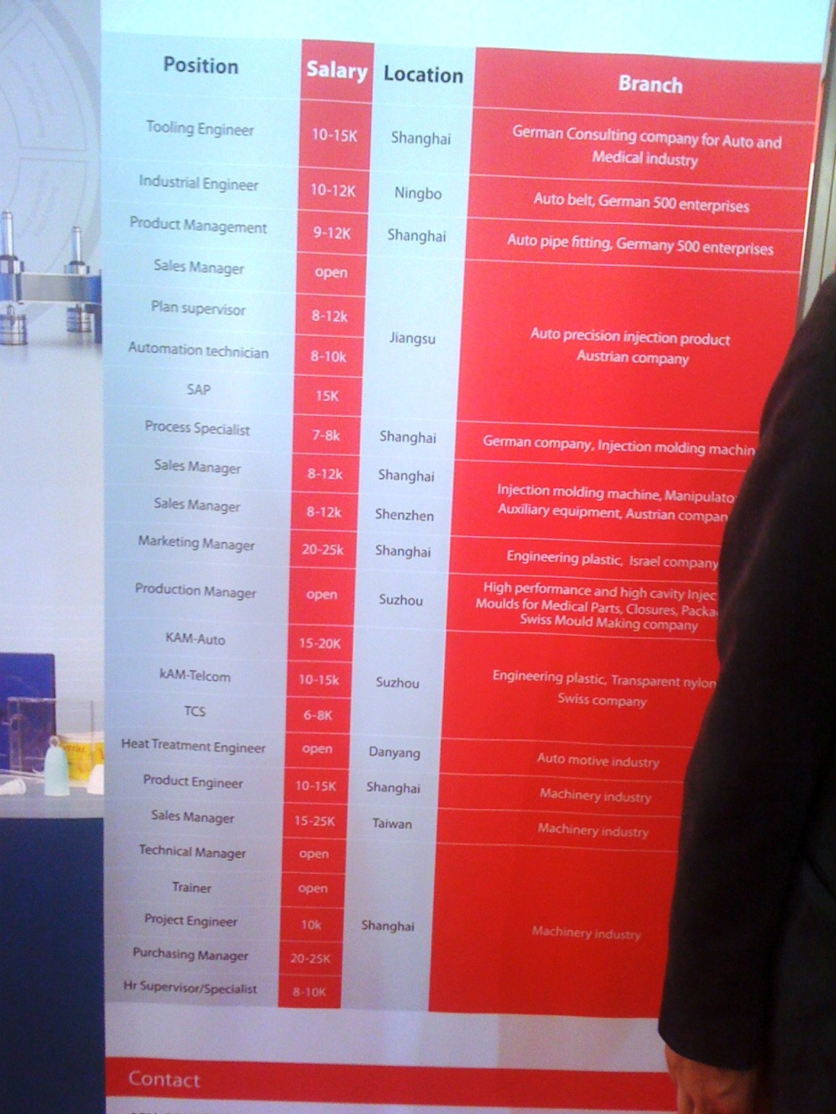
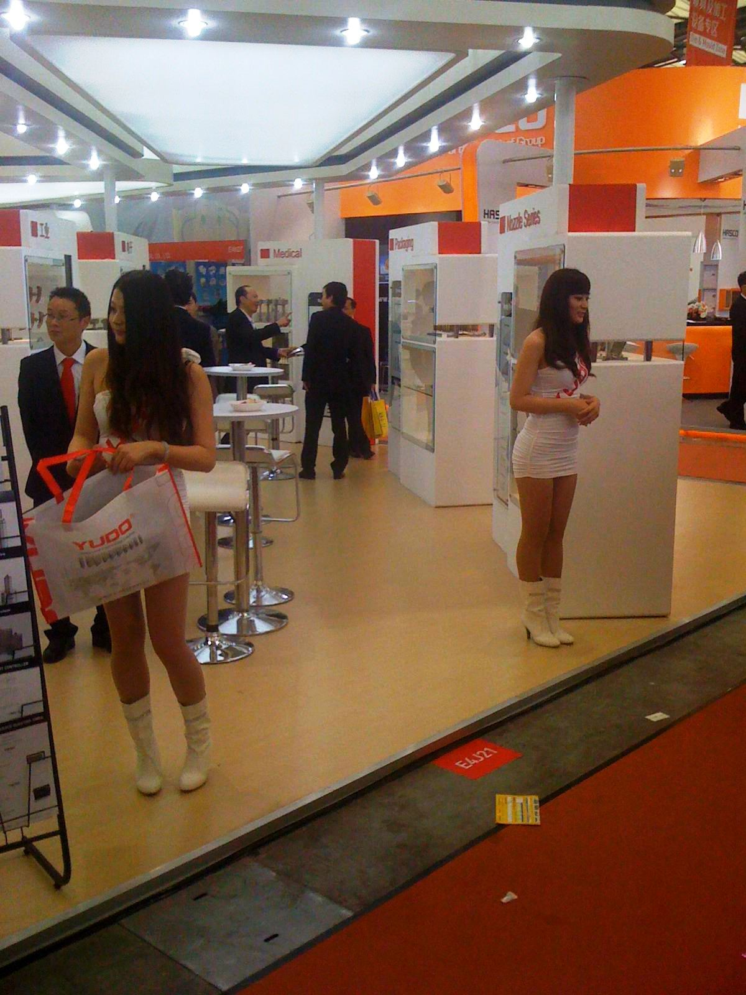

Slide 3
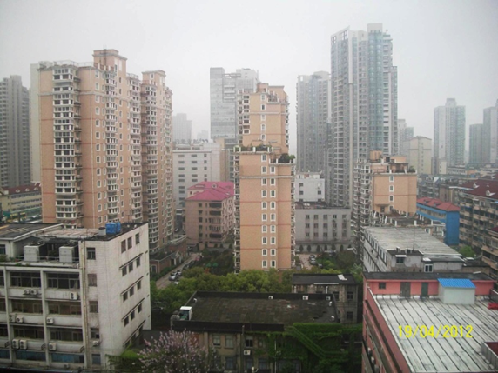
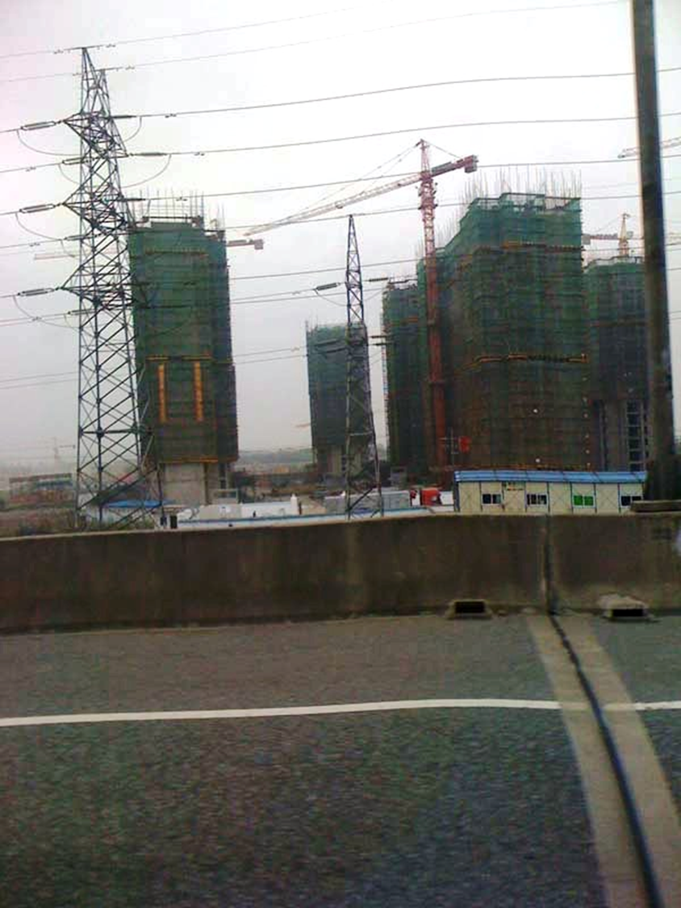

Slide 4
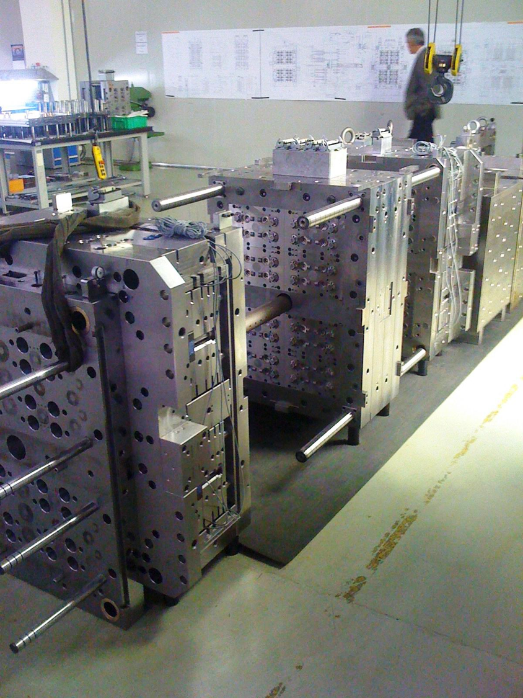

Slide 5
Purpose Of Visit
Check status of Chinese mould making – quality, cost, lead times, etc.
Evaluate perception of China being cheap with low quality.
Visit Chinaplas 2012
Investigate using “Chinese Threat” to the South African mould making Industry

Slide 6
The Scope Of The Visit
Visited three factories – two in the Shenzen area in the south and one outside of Shanghai.
Also attended Chinaplas – the Chinese Plastics industry trade show - where there were many mouldmakers exhibiting.
Some specialised in Closures, Packaging and Medical. This was a common grouping.
Some specialised in Automotive.
Some specialised in Household Goods.

Slide 7
Conclusions Drawn From Visit
Quality is definitely improving.
Machines in the factories which we visited were often quality machines such as DMG, Charmilles and Mazak.
On the software side, Autocad and Solidworks are extensively used. Process controls are in place
European influence in China.
Some European companies have set up partnerships with Chinese mould suppliers - manufacturing in China - and this has certainly contributed to an improvement in quality.

Slide 8
Continuation of
Conclusions Drawn From Visit
As far as prices go, the devil is in the detail.
They always seem to start with very low prices – seemingly impossible to match.
These prices are based on Chinese steels, components and hot runner systems.
However, once you start specifying detail – steel type (including Chinese or European version of the same grade), hot runner type, mould life expectancy (short or long guarantee) – and comparing eggs with eggs, then the price differential between our prices and theirs is not that big.

Slide 9
Continuation of
Conclusions Drawn From Visit
For example:
A fully detailed quote which we requested for an eight cavity mould, came in at 10% lower than what we could make it for. Lead time to first sampling was quoted at 10 weeks. Note that this example was from a high quality Chinese manufacturer.

Slide 10
Continuation of
Conclusions Drawn From Visit
Labour is their biggest cost saver.
The workers – CNC operators, toolmakers - work a six day week and live in dormitories on the site of the factory.
They work 12 hour shifts. For this they are paid around 5000 RMB (Chinese dollar- which is only slightly stronger than our Rand) per month!
Their meals and accommodation are free albeit extremely basic. We had the opportunity to look inside a dormitory – three by three meter rooms with double bunk bed and a television. No other furniture.

Slide 11
Continuation of
Conclusions Drawn From Visit
Unfortunately there are many horror stories of South African manufacturers who have fallen to the lure of cheap Chinese moulds.

Slide 12
How We Can Compete
Build on the advantage of our experience, knowledge and attention to quality.
Strive to continuously improve.
Maximise our efficiency potential. Utilize unmanned hours, find improved methods of doing things.

Slide 13
Continuation of
How We Can Compete
Good equipment is essential. You can’t compete in Formula One driving a Tata.
Unfortunately good equipment comes with a higher price tag. We are pretty certain that the Chinese government sponsor their tool shops – judging by the equipment which they (the better ones) seem to have.
This is why we believe it’s so important that our government follows through on their offer on funding to the toolmaking industry.
Their problem of course is that they can’t just hand out money willy nilly to any comers. That would be pouring taxpayer’s money down a bottomless pit.

Slide 14
Continuation of
How We Can Compete
Utilize our advantage of being close to the customer. Provide a complete service including new moulds, servicing and maintenance and repairs.
For the manufacturer, purchasing the mould or tool is only a first step. Keeping the thing producing effectively for the duration of its life expectancy is the challenge and having back-up support at hand (as opposed to half way around the world) is essential.

