Slide 1
PtSA Membership Benefits

Slide 2
The Production Technologies Association of South Africa (PtSA) is a membership-based organisation:
Mission
Promoting, protecting and supporting the collective interests of the Tool, Die, Mould and Special Machining Industries of South Africa in continual support of the growth and development of all manufacturing sectors
Vision
To safeguard and expand the South African Manufacturing sector for the benefit and prosperity of all its people
International Partnership
PtSA is a member of the International Special Tooling and Machining Association (ISTMA)

Slide 3
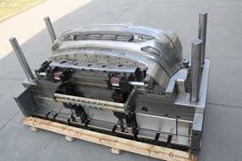
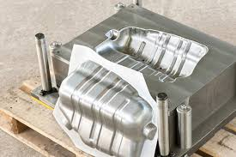
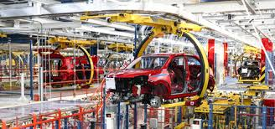
What makes it different
PtSA is the only Association which focusses exclusively on the TDM Industry in South Africa
PtSA has a partnership agreement with government to support the TDM Industry

Slide 4
PtSA is the collective voice of the TDM industry
Regional executive committees co-ordinate inputs from members in each region in order to assist with formulating national strategies for engagements with government and authorities.
A partnership agreement with government (INTSIMBI Future Production Technologies Initiative) facilitates dialogue between its own (TDM) industry and government.
INTSIMBI Future Production Technologies Initiative
Governance, Execution and Monitoring Structure
Unique governance and implementation structures were created for the Intsimbi FPTI at national and provincial levels to enable the establishment of project-level partnerships for project funding and execution.
A Section 21 company was created at national level to enable industry and government stakeholders to participate in the guiding and monitoring of the execution of the Intsimbi FPTI programmes.
Members have the opportunity to participate in interactive dialogue with government and authorities regarding the development of the industry.
Eastern Cape Investment to date
Total R110 Million Direct and Indirect

Slide 5
Improvement of competitiveness of PtSA members
International benchmarking process to its members.
Implementation of productivity improvement programmes for member companies.
Eastern Cape
28 Companies Benchmarked
5 Intervention Projects
Facilitates the funding of selected productivity improvements for member companies.
Facilitates the growth of the supplier base for the benefit of the larger corporates, and in particular the OEM's.

Slide 6
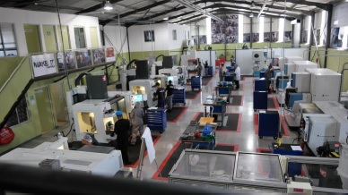
Training and upskilling programmes
SAQA approved artisan qualifications and training programmes for the tooling industry.
Accredited training facilities in Western Cape, Eastern Cape, Gauteng and KwaZulu-Natal as the base for these artisan training programmes.
Short courses are available to its members in order to continuously improve the level of skills within member companies, and in particular with regard to new technologies.
Toolmaking and machinist training programmes that ensure trained artisans are available to the industry.

Slide 7
INTERNATIONAL CONNECTIONS ISTMA World
PtSA is a member of ISTMA
The International Special Tooling & Machining Association (ISTMA) is an international association representing 21 Countries throughout the world.
Collectively, ISTMA member associations represent over 8,000 companies with over 120 billion US dollars in annual sales.
ISTMA World is responsible for the central coordination and organization of all international activities.
For over fifty two years, a firm partnership for stamping dies, mould making, precision machining and special machines has evolved.
Be it a toolmaker in Tokyo, a mould maker in Barcelona, a machinist in Canada, or a special machine builder in the United States, the industry associations, member companies, and employees benefit from ISTMA membership Links to ISTMA World.

Slide 8
Networking, matchmaking and information programmes
The association has a large and comprehensive database which is utilised for the benefit of members.
Hosts an annual convention to facilitate interaction amongst members and to assist with the communication of developments in the industry.
Facilitates Business to Business (B2B) introductions.
Hosts regular Networking meetings in the Western Cape, Eastern Cape, Gauteng and KwaZulu-Natal.

Slide 9
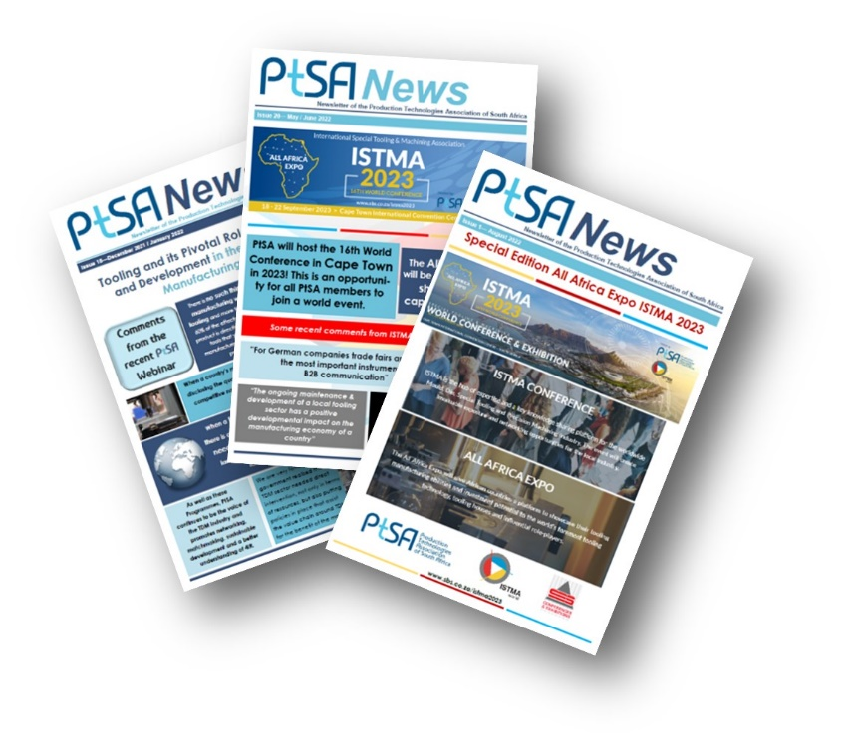
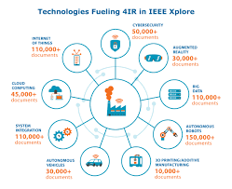
PtSA corporate facilities are available for use by its members
Board meetings;
Conferencing;
Training.
PtSA website provides information about international and national news, events and trends in the industry.
Better understanding of the Fourth Industrial Revolution (4IR)
PtSA facilitates the understanding of technology developments for its members by means of information programmes, demonstrations, publications and networking;

Slide 10
Who is eligible for Membership
Membership of PtSA is open to any company or organisation involved in the Tool, Die, Mould and Specialised Machining Industries in South Africa, and companies which are wholly dependent on tooling for their production processes:
as manufacturers;
as suppliers;
as support services.
Industry Membership
For companies actively involved in the design and manufacture of Tools, Dies, Moulds and Manufacturing systems, as well as companies undertaking Specialised Machining and companies which are wholly dependent on tooling for their production processes.
Associate Membership
Generally, for companies which are customers of, or suppliers to the Tool, Die, Mould and Specialised Machining industry.
Institutional Membership
Generally, for associations, academic institutions or colleges, etc.
Registered Individual Membership
Generally, for toolmakers, technicians, engineers or relevant interested parties employed in the Tool, Die, Mould and Specialised Machining industries.

Slide 11
Join the Best
Become part of the Association that represents the network of companies which forms the Tool, Die, Mould and Specialised Machining industry in South Africa:
Participate in the benefits of membership;
Support the growth of manufacturing in South Africa.
Theo van Rooyen (Eastern Cape)
Mobile: +27 (0)82 562 3087
E-mail: theovr@ptsa.co.za
Francois Beetge (Gauteng)
Mobile: +27 (0)79 504 9387
E-mail: francoisb@ptsa.co.za
André Davies (Western Cape)
Mobile: +27 (0)62 813 1301
E-mail: andred@ptsa.co.za
Richard Kannigan (KwaZulu-Natal)
Mobile: +27 (0)73 418 5044
E-mail: richardk@ptsa.co.za

